Slide 1
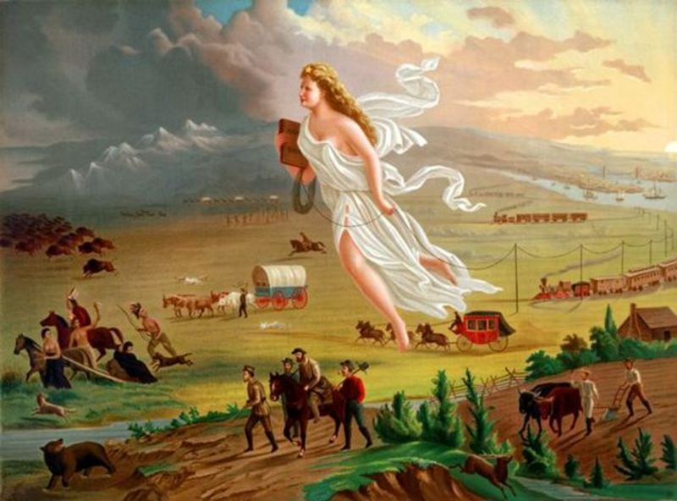
American Progress – John Gast (1872)
History Scene Investigation

Slide 7
New Vocabulary
Manifest Destiny - the 19th-century belief that the expansion of the US throughout the American continents was both justified and inevitable.
Westward Expansion – the acquiring of land that ultimately lead to the growth of the United States.

Slide 8
Reasons for Manifest Destiny
Term first coined by John L. O’Sullivan in Democratic Review, July 1845
Reasons for this belief:
Sincere belief in democracy and republicanism
Idealized view of U.S. as model for others
Ideology intertwined with racist and imperialistic [extending your country’s power] ideas about American Indians and Mexicans
Tied to religion “God wants our nation to Grow”
Less separation of church and state during this time period

