Slide 1
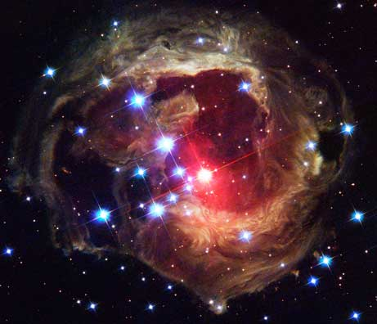
Characteristics of Stars

Slide 2
Distances To The Stars
Stars are separated by vast distances.
Astronomers use units called light years to measure the distance of stars
A light-year is the distance that light travels in a vacuum in a year
Proxima Centauri, is the closest star to the sun.

Slide 3
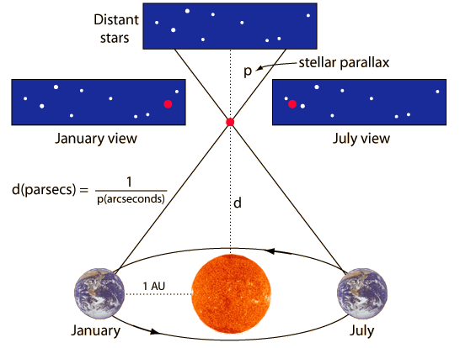
Parallax
Astronomers have developed various methods of determining the distance of stars.
The change in position of an object with respect to a distant background is called parallax.
As Earth moves in its orbit, astronomers are able to observe stars from two different positions.
Astronomers measure the parallax of nearby stars to determine their distance from Earth

Slide 4
Characteristics of Stars
The Sun is an average star:
it’s not hot or cool
it’s not large or small.
We can compare stars by temperature, size, & brightness.

Slide 5
The Sun is larger than 95% of the stars.
Dwarf Star Sun Giant Star Super Giant Star

Slide 6
Color and Temperature
Color:
Stars range in color from red, orange, yellow, white, to blue.
Red ----------- Yellow (Sun) ----------- > Blue
Temperature:
Stars range in temperature from 2000ºC--50 000ºC.
2 000ºC ---------5 000ºC (Sun)--------- > 50 000ºC

Slide 7
Color and Temperature
Color and temperature are linked.
The 2000ºC stars are red in color.
The 50 000ºC stars are blue in color.

Slide 8
Color and Temperature
color | Temp. Range (ºC) | Examples
Blue | 25000 – 50 000 | Zeta Orionis
Bluish-white | 11 000 – 25 000 | Rigel, Spica
White | 7 500 - 11 000 | Vega, Sirius
Yellowish-white | 6 000 - 7 500 | Polaris, Procyon
Yellow | 5 000 - 6 000 | Sun, Alpha Centauri
Orange | 3 500 - 5 000 | Arcturus, Aldebaran
Red | 2 000 - 3 500 | Betelgeuse, Antares

Slide 9
Brightness
Brightness is related to the distance from the earth and the age of the star.
Hipparchus developed the idea of classifying stars by their brightness.
1st magnitude stars are the brightest
6th magnitude stars are the weakest

Slide 10
Apparent Magnitude – refers to the brightness of a star as it appears to us.
Absolute Magnitude – refers to the actual amount of light given off by a star at a standard distance.

Slide 11
HR Diagram
An HR diagram shows the two most important characteristics of stars, which are temperature and absolute magnitude (brightness) and/or luminosity.
Scientists plot the surface temperatures of stars and their brightness on a graph.

Slide 12
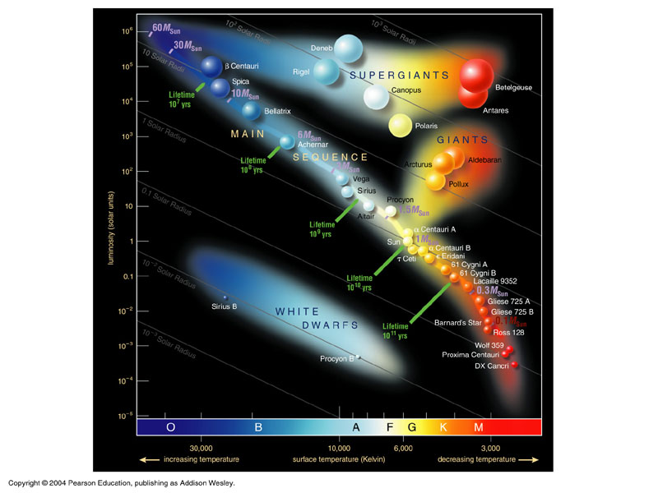

Slide 13
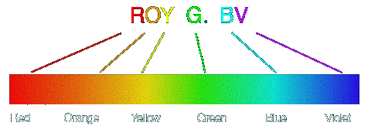
Spectrum
Spectroscope: Used to measure the chemical composition of the stars. (also temperature and direction the star is moving in relation to the Earth.)
How? Set up a spectroscope with different tubes; each gas has different spectras – light patterns.

Slide 14
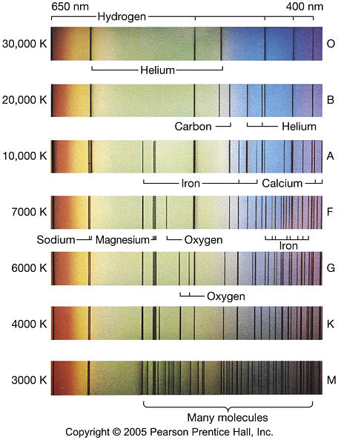

Slide 15
Questions
How is the color of a star related to its temperature?
The color of a star depends on its temperature, from red and orange (cool stars) to yellow and white (hotter stars) to blue (very hot stars).
2. Explain why a cooler star could actually appear brighter than a hotter star.
A cool star, such as a red giant, could be either closer to us or much larger than a hotter star, such as a white dwarf. (Could be closer and larger)

