Slide 1
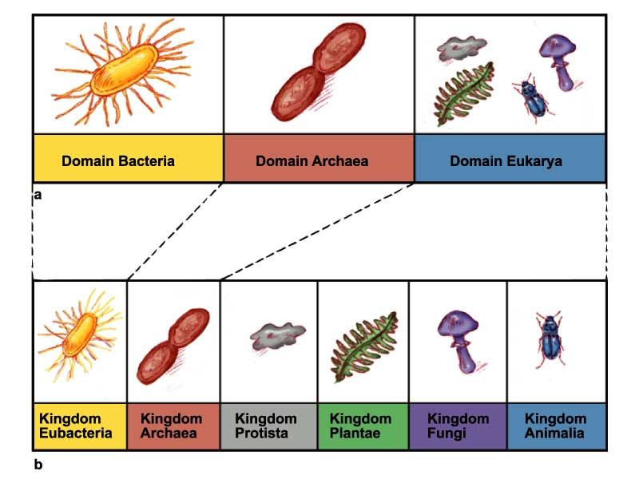
Classification of Living Things

Slide 2
A Little History
The Earth is 4.6 billion years old and microbial life is thought to have first appeared between 3.8 and 3.9 billion years ago.
In fact, 80% of Earth's history was exclusively microbial life.
Microbial life is still the dominant life form on Earth.
The National Science Foundation’s “Tree of Life” project estimates that there could be anywhere from 5 million to 100 million species on the planet, but science has only identified about 2 million.
“We’ve only touched the surface of understanding animal life,” said entomologist Brian Fisher of the California Academy of Sciences. “We’ve discovered just 10 percent of all living things on this planet.”

Slide 3
Why do we classify things?
  Supermarket aisles
  Libraries
  Classes
  Teams/sports
  Members of a family
  Roads
  Cities
  Money

Slide 4
What is classification?
Classification: putting things into orderly groups based on similar characteristics
Taxonomy: the science of describing, naming, and classifying organisms

Slide 5
Early classification
Aristotle grouped everything into
simple groups such as animals or plants
He then grouped animals according to if they had blood or didn’t have blood, and if they had live young or laid eggs, and so on…

Slide 6
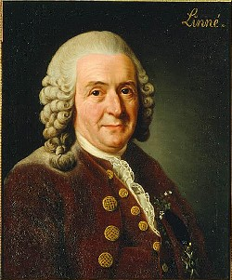
Binomial Nomenclature
Developed by Carolus Linnaeus
Swedish Biologist 1700’s
Two-name system
Genus and species named using Latin or Greek words

Slide 7

When Linnaeus developed his system of classification, there were only two kingdoms, Plants and Animals. However, the use of the microscope led to the discovery of new organisms and the identification of differences in cells. A two-kingdom system was no longer useful.
Today the system of classification includes six kingdoms.
The Six Kingdoms:
Plants, Animals, Protists, Fungi, Archaebacteria, & Eubacteria.
How are organism placed into their kingdoms?
· Cell type, complex or simple
· Their ability to make food
· The number of cells in their body

Slide 8
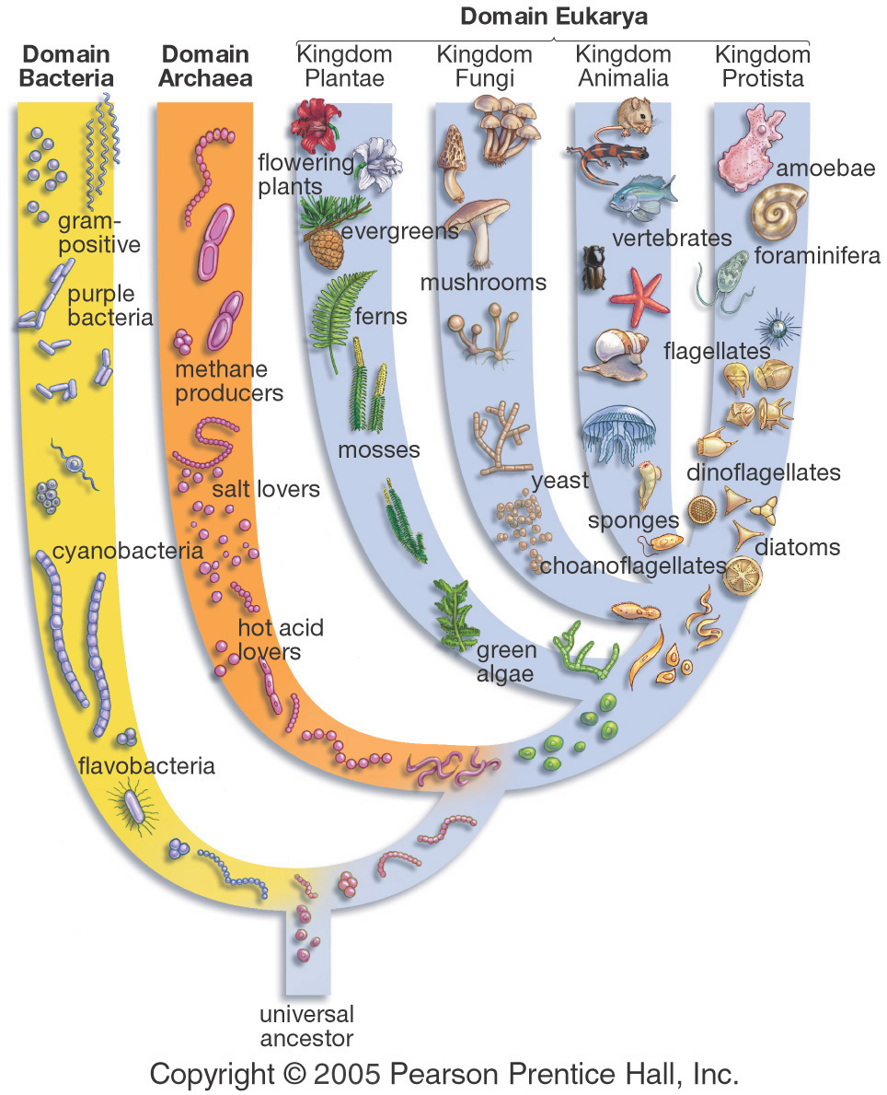

Slide 9
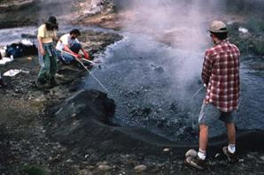
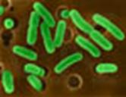
Archaebacteria
In 1983, scientists took samples from a spot deep in the Pacific Ocean where hot gases and molten rock boiled into the ocean from the Earth’s interior. To their surprise they discovered unicellular (one cell) organisms in the samples. These organisms are today classified in the kingdom, Archaebacteria.
Archaebacteria are found in extreme environments such as hot boiling waterand thermal vents under conditions with no oxygen or highly acid environments.
Finding Archaebacteria: The hot springs of Yellowstone National Park, USA, were among the first places Archaebacteria were discovered. The biologists pictured above are immersing microscope slides in the boiling pool onto which some archaebacteria might be captured for study.

Slide 10

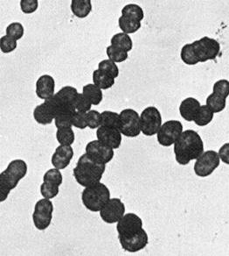
Eubacteria
Like archaebacteria, eubacteria are complex and single celled. Most bacteria are in theEUBACTERIA kingdom. They are the kinds found everywhere and are the ones people are most familiar with.
Eubacteria are classified in their own kingdom because their chemical makeup is different.
Most eubacteria are helpful. Some produce vitamins and foods like yogurt. However, these eubacteria, Streptococci pictured above, can give you strep throat!
One celled
No separate nucleus
Example: bacteria

Slide 11
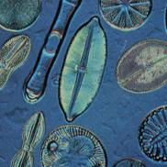

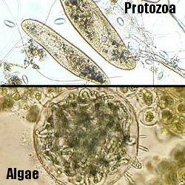
Protist
Protists
Slime molds and algae are protists.
Sometimes they are called the odds and ends kingdom because its members are so different from one another. Protists include all microscopic organisms that are not bacteria, notanimals, not plants and not fungi.
Most protists are unicellular. You may be wondering why those protists are not classified in the Archaebacteria or Eubacteria kingdoms.
It is because, unlike bacteria, protists are complex cells.
These delicate looking diatoms are classified in the protist kingdom.
Most one celled
Have nucleus and other cell structures
Examples: algae, amoeba

Slide 12
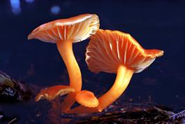
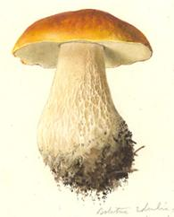
Fungus
Fungi
Mushrooms, mold and mildew are all examples of organisms in the kingdom fungi.
Most fungi are multicellular and consists of many complex cells.
Fun Facts about Fungi
Some fungi taste great and others can kill you!
Fungi are organisms that biologists once confused with plants, however, unlike plants, fungi cannot make their own food. Most obtain their food from parts of plants that are decaying in the soil.
Many celled
Cannot move
Absorb nutrients from other organisms
Examples: mushrooms, yeast, molds

Slide 13
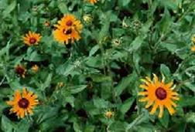

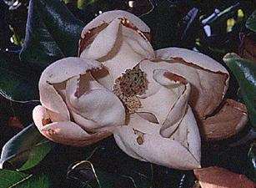
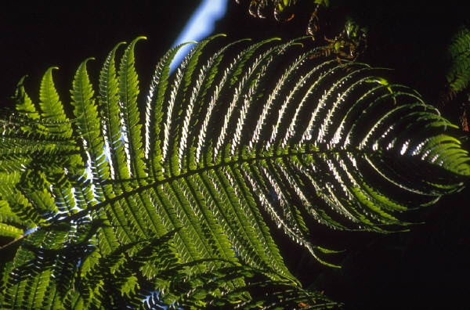
Plant
You are probably quite familiar with the members of this kingdom as it contains all the plants that you have come to know - flowering plants,mosses, and ferns. Plants are all multicellular and consist of complex cells.
With over 250,000 species, the plant kingdom is the second largest kingdom. Plant species range from the tiny green mosses to giant trees.
In addition plants are autotrophs,organisms that make their own food.
Many-celled
Cannot move
Autotrophs (Use energy from the sun to make sugars)

Slide 14
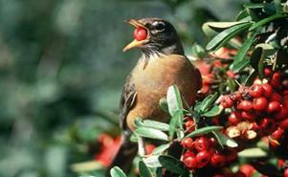
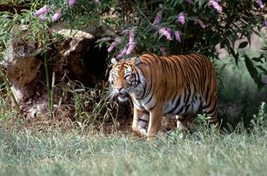
Animal
Animals
The animal kingdom is the largest kingdom with over 1 million known species.
Sumatran Tiger - Kingdom: Animalia, Phylum, Chordata, Class Mammalia, Order Carnivora, Family Felidae, Genus Pathera, Species tigris
All animals consist of many complex cells. They are also heterotrophs.
Members of the animal kingdom are found in the most diverse environments in the world.
Many-celled
Most can move
Get energy by consuming other organisms
Examples: invertebrates, fish, birds, mammals

Slide 15
The modern system of classification has 8 levels:
Domain
Kingdom
Phylum
Class
Order
Family
Genus
Species

Slide 16
Helpful way to remember the 8 levels
Dumb kids playing catch on freeways get squashed
Or…make up your own…
  D K P C O F G S

Slide 17
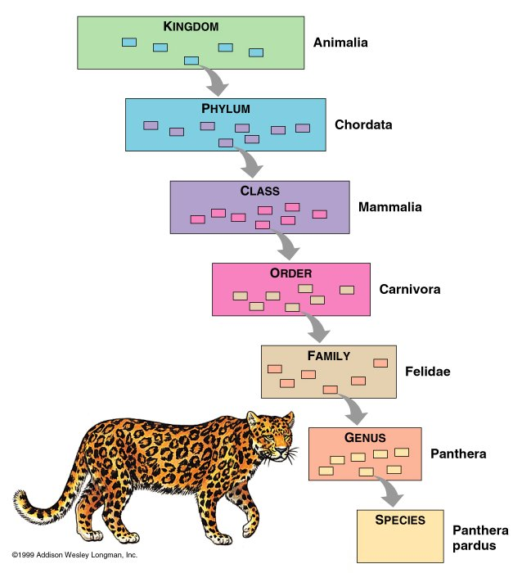

Slide 18
Using the Classification System
Field guides help identify organisms.
-they highlight differences between similar organisms (like trees)
Taxonomic Key (Dichotomous Key)
-paired statements that describe the physical characteristics of different organisms

Slide 19
Rules used to write scientific names
Homo sapiens
An organism’s genus is always written first; the organism’s species is always written second
The genus is Capitalized; the species is
  written in lower case
Scientific names of organisms are always italicized or underlined

Slide 20
Modern Taxonomy
The Evidence used to classify into taxon groups
  1) Embryology (splits animal kingdom)
  2) Chromosomes / DNA
  3) Biochemistry
  4) Physiology (structure/function)
  5) Evolution
  6) Behavior

Slide 21
Taxonomic Key
1a Fruits occur singly ................................................. Go to 3
1b Fruits occur in clusters of two or more ................ Go to 2
2a Fruits are round ................................................... Grapes
2b Fruits are elongate ............................................... Bananas
3a Thick skin that separates easily from flesh .........Oranges
3b Thin skin that adheres to flesh .............................. Go to 4
4a More than one seed per fruit ............................ Apples
4b One seed per fruit ............................................ Go to 5
5a Skin covered with fuzz.................... Peaches
5b Skin smooth, without fuzz........................... Plums
What steps would you use to identify an apple?

