Slide 1
The Compromise of 1850

Slide 2
The Santa Fe Question
During the Republic of Texas, Texas claimed the Rio Grande as its southern and western border.
This claim gave Texas control of about one-half of New Mexico, including the important trade center of Santa Fe.
Many people of Santa Fe did not want to be part of Texas, and many people in the northern U.S. feared that Texas would introduce slavery there.

Slide 3
Everything’s bigger in Texas…
When Texas was annexed by the United States in 1845, many people worried about Texas upsetting the balance between slave states and free states.
With Texas, the South would have more power in Congress.

Slide 4
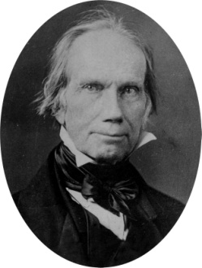
…until the Compromise of 1850
Henry Clay, a congressman from Kentucky, worked out a solution.
In the Compromise of 1850…
Texas agreed to surrender its claims to some disputed areas (New Mexico and part of Texas’s northern territory)
The US agreed to give Texas $10 million in return
California was admitted to the U.S. as a free state
Territories could vote on the issue of slavery
Stronger Fugitive Slave Act and ban on slavery in Washington D.C.

Slide 5
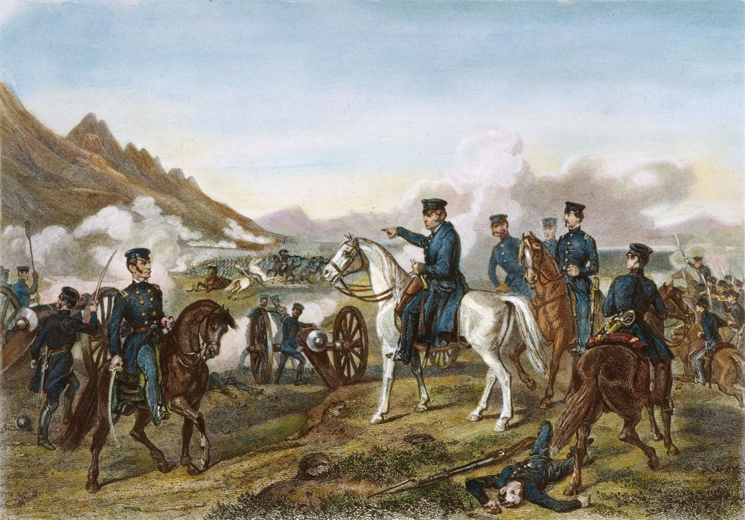
What happened to Mexico?
After the Mexican-American War (1846-1848), Mexico ceded, or gave up, land that now makes up many of the southwestern states.

Slide 6
Before the Compromise of 1850

Slide 7
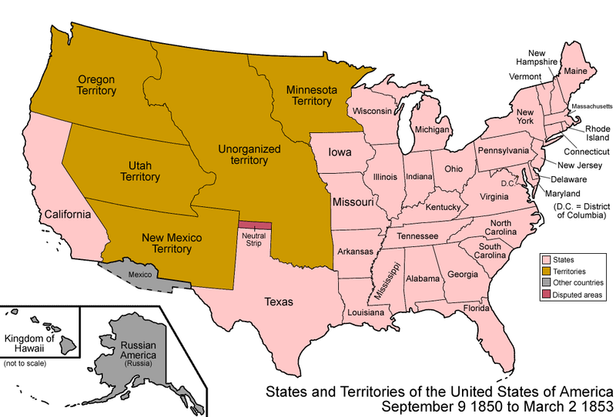
After the Compromise of 1850

Slide 8
A Lasting Solution?
The Compromise of 1850 helped the United States avoid sectional conflicts, secession (withdrawal from the United States), and civil war for several years.
However, what eventually happens next?
Stay tuned!

