Slide 1
Expanding Territory (Take notes on pages 80 & 81)

Slide 2
Let’s Review
Spain becomes the only remaining European power in Texas.
The French came to Texas and leave, but they claim Louisiana for France.

Slide 3
Meanwhile…elsewhere in the world
American Revolution (1775-1783)
French Revolution (1789-1799)

Slide 4
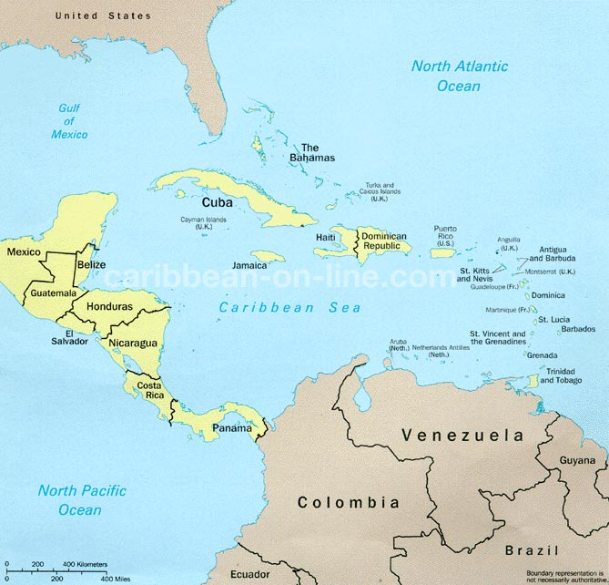
France in the New World
France acquires Haiti
The Haitians win their independence from France
The French decide to withdraw from most of North America and need to decide what to do with one very large territory…

Slide 5
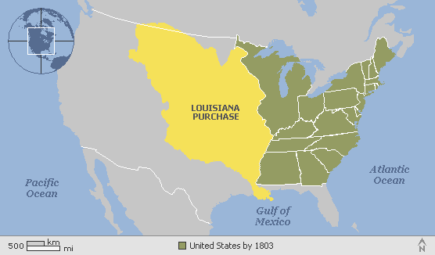
Louisiana Purchase (1803)
France sold the are known as the Louisana Purchase to the United States for
$15 million – a bargain!

Slide 6
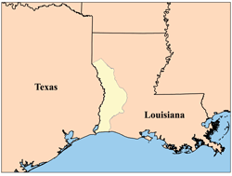
Conflict over Borders
The U.S. wants American territory to extend to the Sabine River and maybe even include Texas.
Spain wants Texas to extend to the Calcasieu River in Louisiana.
Neutral Ground

Slide 7
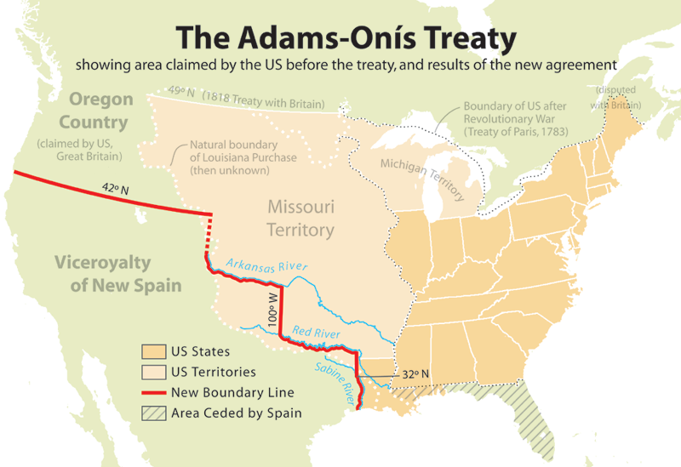
1819

