Slide 1
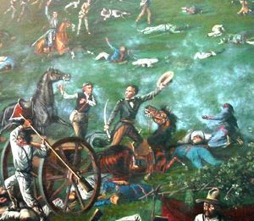
Battle of San Jacinto & the Treaty of Velasco

Slide 2
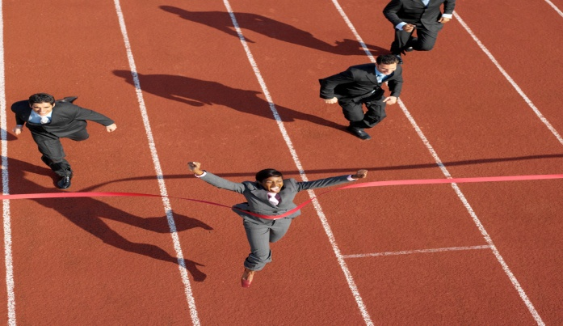
1.The Battle of San Jacinto: the last battle of the Revolution.
TRUE!
Last battle of the Revolution
April 21, 1836
First Battle: Battle of Gonzales (10/2/1835)

Slide 3
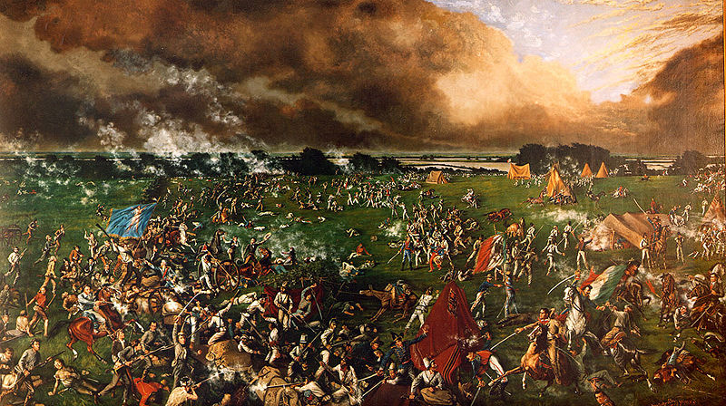
2. The Texans lost the battle of San Jacinto.
FALSE!
Texans win the battle & win their independence!
Texans win because:
  Took Mexicans by surprise
  Mexicans were tired & unprepared
  Inspired by Alamo & Goliad
  Santa Anna is overconfident
  Texas army finally trained

Slide 4
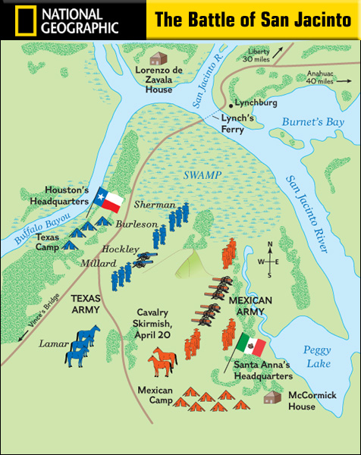

Slide 5

3. The battle lasted for only 2 days.
False!
The Siege at the Alamo lasted 13 days, San Jacinto battle lasted only 18 minutes.

Slide 6
4. Only 9 Texans died in the Battle of San Jacinto.
TRUE!
About 700 Texans v. 1,000 Mexicans
9 Texans die, 650 Mexicans die

Slide 7

5. Santa Anna was distracted by a woman during the battle.
TRUE! (Maybe)
The Yellow Rose of Texas is a song about how a slave named Emily Morgan who helped win the battle of San Jacinto. The real yellow rose was Emily D. West, a housekeeper who worked nearby the New Washington Hotel.

Slide 8
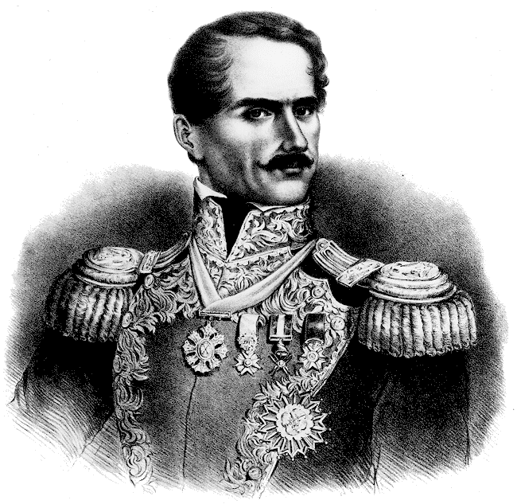
6. Santa Anna’s addiction to drugs helped the Texans win the battle.
TRUE!
Santa Anna was addicted to drugs and alcohol and abused both during the Texas Revolution.

Slide 9
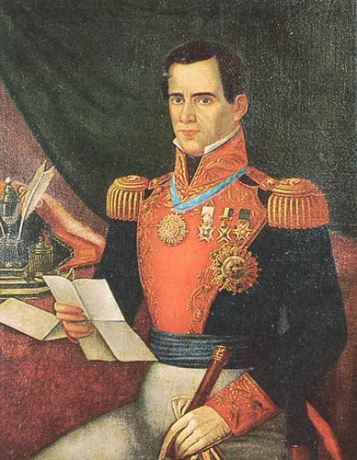
7. The Texans executed Santa Anna when the revolution was over.
FALSE!
Texans wanted Houston to kill Santa Anna but he didn’t.
Instead he made him sign the Treaty of Velasco ending the war and recognizing Texan independence.
If he didn’t, Mexicans would have been more upset and may not have recognized the Republic of Texas.

Slide 10
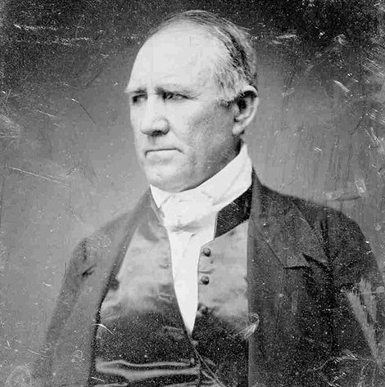
8. Sam Houston was shot in the buttocks during the battle.
FALSE!
During this engagement, his horse, Saracen, was shot beneath him, and Houston was wounded severely just above the right ankle.

Slide 11
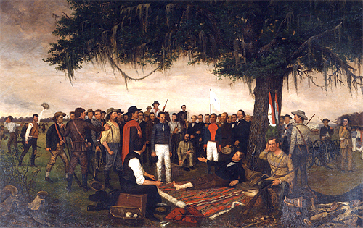
9. Santa Anna agreed to let Texas become a separate country.
TRUE!
Santa Anna is captured and forced to sign the Treaty of Velasco which made Texas a separate country.
Unfortunately, he goes back on his word.

Slide 12
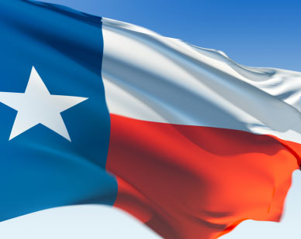
10. There were two versions of the Treaty of Velasco.
TRUE!
Velasco: May 14th, 1836
Treaty One (public): never fight again, all Mexican forces ordered out of Texas, exchange of prisoners, property Mexicans claimed were to be returned
Treaty Two (secret): recognition of Texas independence, work with Mexican government to set boundary at the Rio Grande

Slide 13

11. Texas becomes a part of the United States
FALSE!
Texas does not become a state in the Union until 1845.
The country known as the Republic of Texas existed for 9 years.

