Slide 1
Warm-Up:
If you and a friend were at a concert with general admission and had to save seats for 10 friends, how would you do it?

Slide 2
Unit 4: Spanish & Anglos Settle Texas
Spanish Missions

Slide 3
Review
Native Americans alone in Texas
Spanish Explorers come to Texas
Spanish don’t find much gold and lose interest
French come
Spanish come back and build missions to “save” land

Slide 4
Vocabulary
Settlement
Mission
Presidio
Friar

Slide 5
Vocabulary
Settlement = a small community
Mission = a religious settlement
Presidio = a Spanish military outpost
Friar = member of a Catholic religious order

Slide 6
Spanish Missions
Purpose:
Claim land for Spain
Convert Native Americans to Christianity
First Mission:
Corpus Christi de la Ysleta - 1682
Most Famous Mission:
San Antonio de Valero - 1718 (the Alamo)
Abandoned Missions:
French no longer threat so Spain abandons missions in 1773

Slide 7
Spanish Presidios
Purpose:
Protect Missions from French and Native American attacks
Mission
Mission
Presidio
Mission
Mission

Slide 8
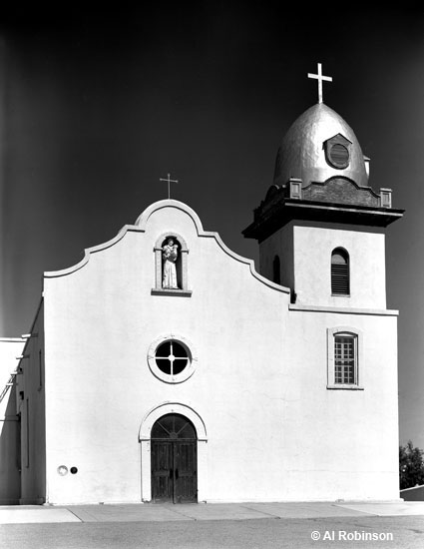
Corpus Christi de la Yselta (1682)

Slide 9
Concepcion Mission in San Antonio (1718)

Slide 10
San Francisco de los Tejas (1690)

Slide 11
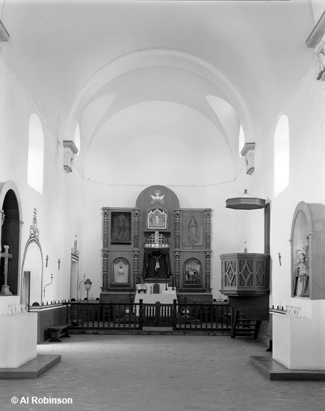
Goliad Mission (1722 & 1749)
Originally built where Fort St. Louis was but later moved to Goliad

Slide 12
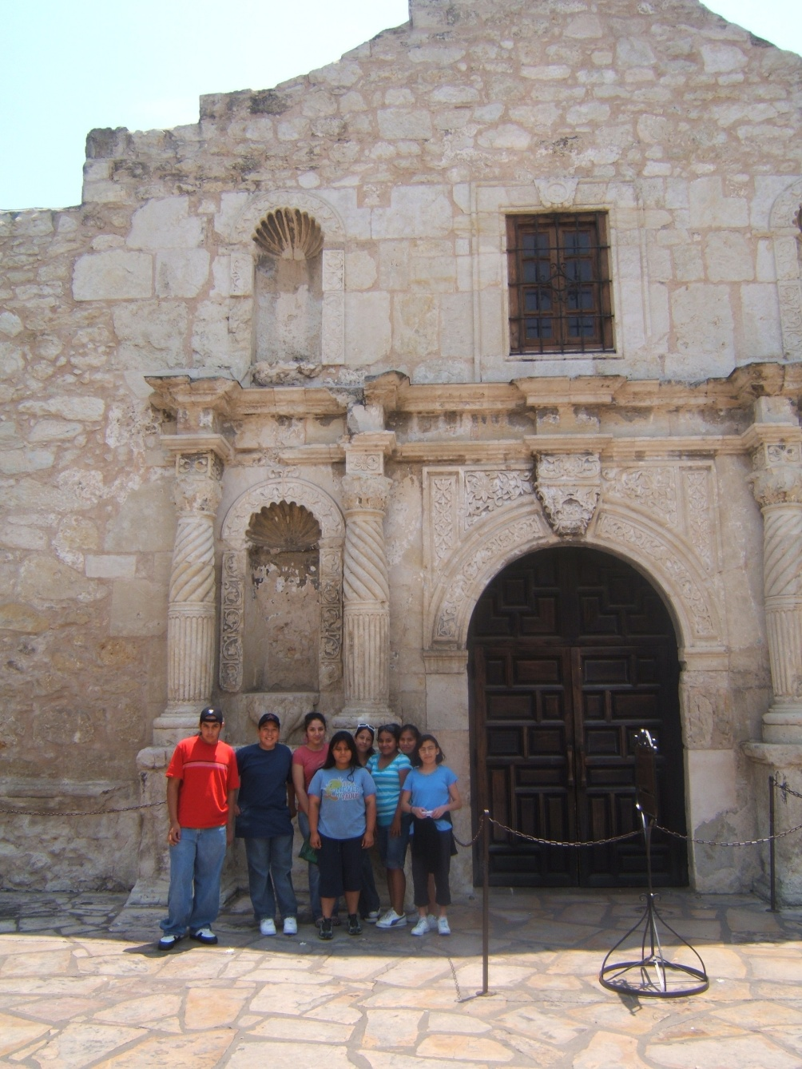
San Antonio de Valero (1718) The Alamo

