Slide 1
Sources
Cindy and Monica were best friends turned enemies but no one knows why. You hear from Jose that Monica is mad at Cindy because she’s dating her crush. However, you talk to Monica and she says she is mad because Cindy talks behind her back not because of a boy. Who do you believe? Why? (3-5 sentences)

Slide 2
Vocabulary
What do you think these words mean? Take a silent educated guess.
Historical Record
Primary Sources
Secondary Sources

Slide 3
Vocabulary
Historical Records – writing that has historical value

Slide 4
Vocabulary
Primary Sources – actual records that have survived from the past, such as letters, photographs, and articles of clothing
Secondary Sources – accounts of the past created by people writing about events sometime after they happened, such as a textbook

Slide 5
Why Use Primary Sources?
Studying primary sources helps you form reasoned conclusions, base your conclusions on evidence, and connect documents to their your context of meaning.

Slide 6
Why Use Secondary Sources?
We use these sources because they are convenient references.

Slide 7
Primary vs. Secondary
I am about to show you slides of different Sources.
Use the index cards provided to let me know if you think the Source is Primary or Secondary.
A for Primary
B for Secondary

Slide 8
Textbook

Slide 9
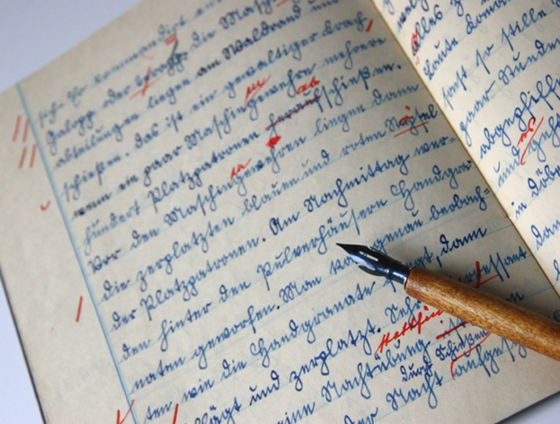
Sam Houston’s Journal

Slide 10
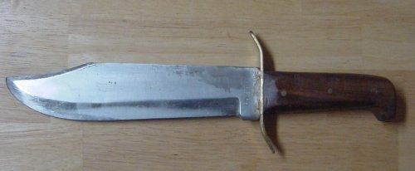
Jim Bowie’s knife

Slide 11
Video of Obama speaking to a crowd

Slide 12
A copy of a John F. Kennedy’s Speech in your Textbook

Slide 13
Newspaper article about the Astros game

Slide 14
A Lil Wayne song

Slide 15
A painting of World War II

Slide 16
My autobiography

Slide 17
A poem about the Texas revolution

Slide 18
If using the internet:
.gov – usually the most reliable
.edu – associated with an educational institution and have high reliability
.org – associated with education and / or non-profit organizations and are generally reliable
.com – established for commerical purposes, tend to be bias in documents choices

Slide 19
Vocabulary
Point of View
Bias

Slide 20
Vocabulary
Point of View- a mental position from which things are viewed.
Bias- a tendency or preference towards a particular perspective

