Slide 1
OPEN UP NOTEBOOKS TO WARM-UPS PAGE

Slide 2
8.30.11 DO NOW
There are over fifty members in my family;
Yet none quarrel. We all live merrily.
Four leaders have we, all with a bride;
Each has a son who has great pride.
We also have servants who make funny gestures;
But they are hardly used, as they often pester.
The peasants are at the bottom of the line;
Although they outnumber us, they haven't a right mind.
What are we?
Notes:
Answer
A Deck of Standard Playing Cards. Fifty-four cards in a standard deck. Four Kings, four Queens, and four Jacks.
The servants are the Jesters. The peasants are the number cards.

Slide 3
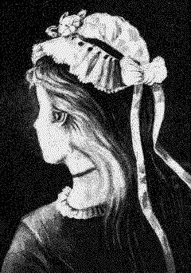


9/6 Warm-up:
WHAT DO YOU SEE?
Young or old?

Slide 4
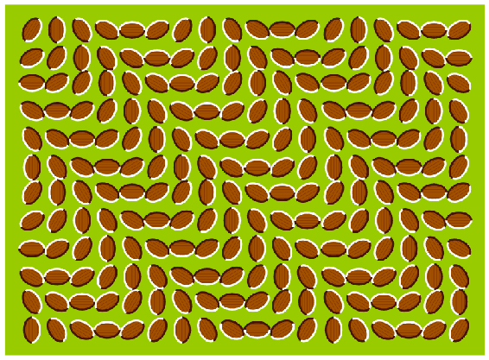
This picture is not animated.

Slide 5
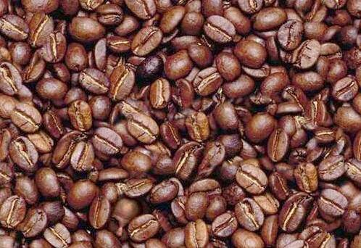
Can you find the face in the beans?

Slide 6
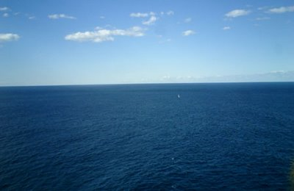
Can you always trust your senses?
It is easy to see why the Earth was once considered flat.

Slide 7
Do Now: Warm-up 9/10/12 (page 3)
Why are safety guidelines important in science?
Can you always trust your senses? Why or why not?

Slide 8
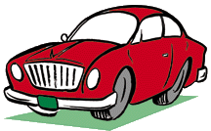

Sparty the Martian
Sparty the Martian was sent to Earth by the Martian government to find life. While on Earth, Sparty captured a car and brought it back to Mars. He thought he'd found a good example of life on Earth. The Martian government does not believe that the car Sparty brought back is alive. Sparty must stand trial for failing to perform his Martian duties. At the trial, Sparty spoke in his defense.

Slide 9
Sparty the Martian
"I first saw these life forms rolling along roads in great numbers. They were giving off thick clouds of poisonous waste as they moved. They seemed to exhibit herding behavior, as many of the cars moved in the same direction. They appeared to have a great deal of energy, some of them moved faster than 60 kilometers per hour. When one of these life forms stopped or slow down, the others behind it responded. They slowed down and gave off a reddish light from the back, and sometimes they would make honking noises. I observed that they would stop to feed on a liquid substance."

Slide 10
Sparty the Martian
Take the part of Sparty's defense attorney and make a good case for the car's being alive. Then be the prosecutor and show that the car is a nonliving thing. List as many reasons as you can.
Defense Attorney (Alive!) 1. ________________________________ 2. ________________________________ 3. ________________________________ 4. ________________________________ 5. ________________________________ ……. | Prosecutor (Not alive…) 1. ________________________________ 2. ________________________________ 3. ________________________________ 4. ________________________________ 5. ________________________________ ……

Slide 11
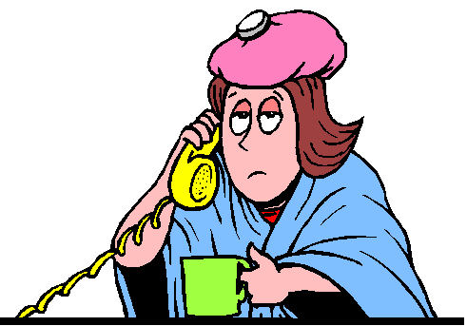
Observation
  What you notice (using 5 senses) in the world around you
  Used to collect data (information)
  This always come first in experiments and labs!
Inference
  Used to interpret data
  States a conclusion

Slide 12
Two types of observations
Quantitative – quantity of item, how many are there? Always a number
Qualitative – quality of the item, such as, color, texture, shape etc

Slide 13
Example: Look at picture
Quantitative Observation – ?
Qualitative Observation – ?
Inference – ?
Notes:
Quantitative Observation – There is 1 girl. She has 1 cup.
Qualitative Observation – pink hat, on yellow telephone, has blue blanket
Inference – She looks sick. She is drinking tea. She is talking to her mom.

Slide 14
DO NOW: Warm-up (last one for page 3, total=3)
Explain in your own words the difference between observation and inference.

Slide 15
DO NOW: Take out your homework from last class and stack it at your table

Slide 16
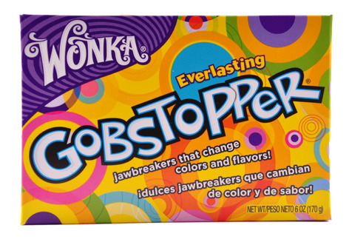
GOBSTOPPER LAB

Slide 17
What science is not…
NOT a process to prove things or to seek truth
NOT based on anything other than the natural world
NOT free from bias or opinions or values
NOT “hunches” or a “feeling” or “idea”
NOT able to solve all problems or answers

Slide 18
No, but it is often A THEORY.
Theory = A well-tested explanation supported by data collected from experiments and observations.

Slide 19
Theories and laws are well-accepted by scientists, but...
THEY ARE NOT SET IN STONE! They CAN change over time with new discoveries!

Slide 20
Experimental group:
  Group that receives the change or
  Group being experimented on
Control group:
  Group that remains constant or NOT changing. This group is your comparison group.
  {May use placebo}
Notes:
20

Slide 21

What is a variable?
What is a variable?
The changing quantities in a science experiment.

Slide 22
Experiments have three kinds of variables:
Independent
Dependent
constants

Slide 23
Variables in an experiment
  Independent variable: (MANIPULATED variable)
- variable being changed/tested.
- The variable that “I” Changed…
- Graphed on the X-axis
  Dependent variable: (RESPONDING variable)
- variable that is measured; it is the result of the change of the independent variable
- it responds to the independent variable.
- Graphed on the Y-axis
Notes:
Variable: attribute which may change its value while under observation/experimentation; is any factor, trait, or condition that can exist in differing amounts or types
Dep. Var.: b/c it will be affected by that variable that you changed before (I.V.).
Ex: For example, if you open a faucet (the independent variable), the quantity of water flowing (dependent variable) changes in response--you observe that the water flow increases. The number of dependent variables in an experiment varies, but there is often more than one.
23

Slide 24
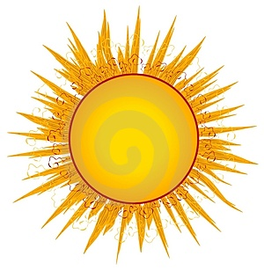

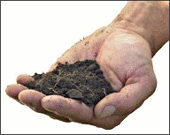
Constants
Constants are things the scientist wants to keep the same.
Notes:
7th

Slide 25
Here are a few examples . . .

Slide 26
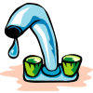
Question:
How much water can flow through a faucet?
Independent Variable?
Dependent Variable?
How much you open the faucet:
half open
closed
all the way open
How much water comes out of the faucet, measured in liters per minute.

Slide 27
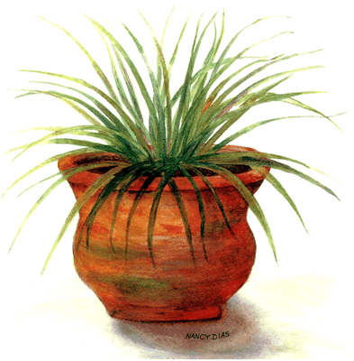
Question:
Does more fertilizer make a plant grow bigger?
Independent Variable?
Dependent Variable?
Amount of fertilizer measured in grams.
Growth of plant by height or number of leaves . . .
Constants?
Same pot type
Same soil
Same sunlight
Same seeds

Slide 28
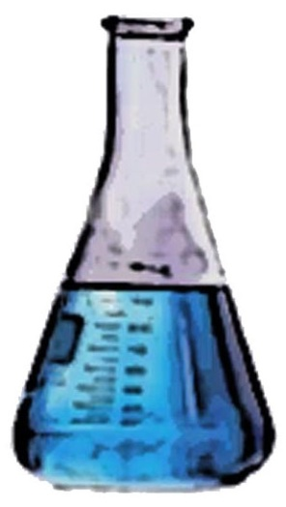

Question:
Does heating a cup of water allow it to dissolve more sugar?
Independent Variable?
Dependent Variable?
Amount of sugar that dissolves completely in the water. Measured in grams.
Temperature of the water, measured in Celsius.
Constants?
Same amount of water
Same type of sugar
Stirring same in each

Slide 29

Question:
Does an electric motor turn faster if you increase the voltage?
Independent Variable?
Dependent Variable?
Voltage of electricity, measured in volts.
Speed of the motor measured in rotations per minute.
Constants?
Same motor for tests

